Slide 1
How do you write and analyse a management case study?
Case centres and case examples
Case competitions
Key features
Limitations of the case method
Analysing case studies
CASE acronym
Bibliography
© 2018 Dr Julie Davies
j.a.davies@hud.ac.uk

Slide 2
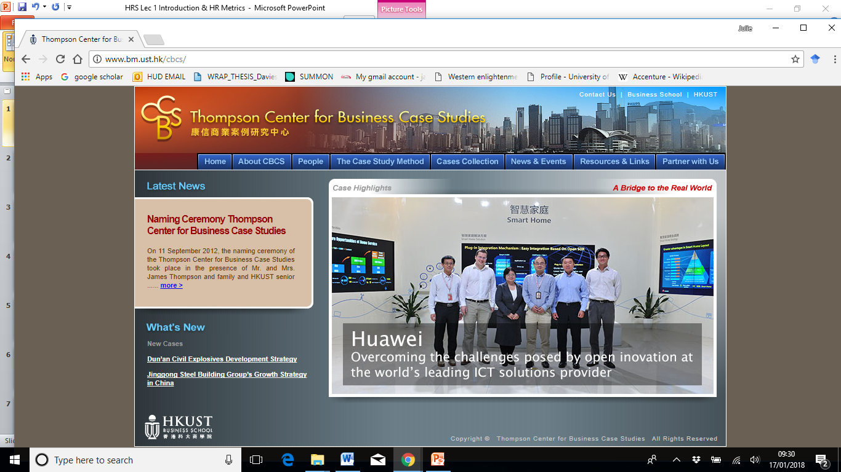
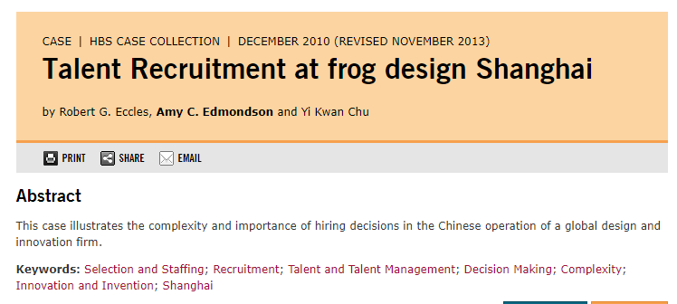
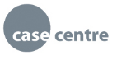
Case centres and case examples
Harvard Business Review
This case illustrates the complexity and importance of hiring decisions in the Chinese operation of a global design and innovation firm.
Keywords: selection and staffing; recruitment; talent and talent management; decision making; complexity; innovation and invention, Shanghai

Slide 3
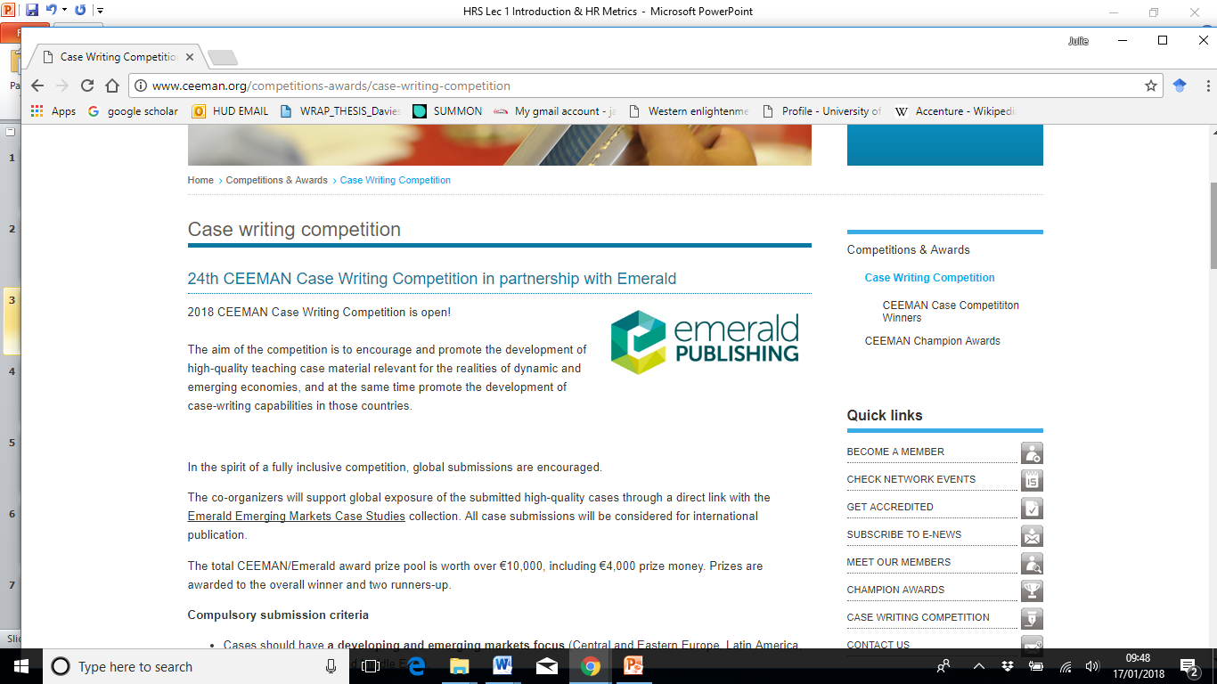
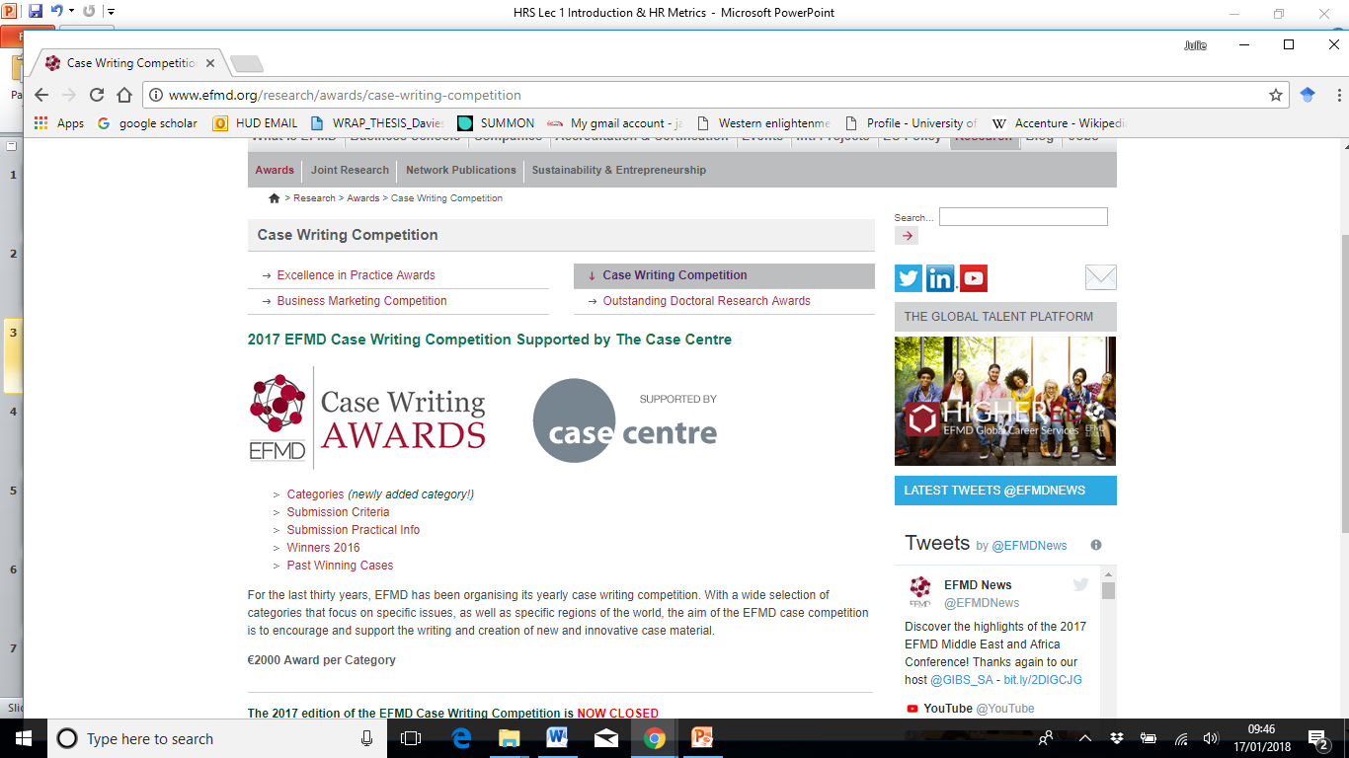
Case competitions
See criteria

Slide 4
Key features
An interesting title with a clear theoretical focus. What is it a case of?
A real life story with well researched evidence that is rigorous and relevant.
Clearly structured subheadings and time frames.
Challenges presented from different perspectives to illustrate learning points.
Creative tensions. There needs to be some drama in the plot and with the actors.
Dilemmas for the reader to justify recommendations (with incomplete information) at a particular point in time. The reader needs to decide.
Useful exhibits of company, industry facts, quotations, financial data, references.
NB: confidentiality, ethics – you must have the organisation’s permission!
Teaching notes for a teaching case highlighting the learning objectives.
Research methods justification and explanation of data analysis, e.g. Gioia method, for dissertations.

Slide 5
Limitations of the case method
Historical, limited material often from a management rather than an employee perspective. One dimensional, limited voices.
Field-work consulting is more dynamic, immediate, political and ‘messy’ like real life.
Who is the author? E.g. consultants to the organisation.
Appreciation of non-Western perspectives?
Cases are necessarily bounded and hindsight makes it easier.
But medicine, law, management use cases to illustrate cases of xyz

Slide 6
Analysing case studies
What are the key facts?
Identify the important challenges – balance theory and practice.
What theoretical models can help you make sense of these?
Use tools for analysis, e.g. SWOT, force field analysis.
Specify alternative courses of action.
Evaluate these options.
Recommend and justify preferred option based on data and theoretical framing.
Evidence, engagement with theoretical concepts, quality of discussion

Slide 7
CASE acronym
C: credible challenge, concepts, characters, context, criticality, comparisons
A: angle, arguments
S: story telling, structured, scenario for reader to make recommendations
E: evidence – use diagrams to make sense of data within management tools and models

Slide 8
Bibliography
Gwee, J. (2018) The Case Writer’s Toolkit. Basingstoke: Palgrave Macmillan.
Gamble, E.M. and Jelley, R.B. (2014) The case for competition: Learning about evidence-based management through case competition. Academy of Management Learning & Education, 13: 433-445.

