Slide 1


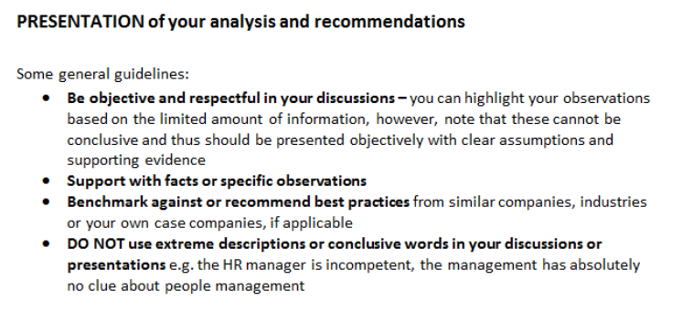





Kajaani Company discussion

Slide 2



1. Reflection and review – based on information you gathered through secondary sources, presentations and discussions during visits 2. Benchmark against the information you gathered from point (3) pre-visit 3. Conduct an objective analysis, and ideas to enhance the human resource management in such type of companies/ industries
POST VISIT

