Slide 1
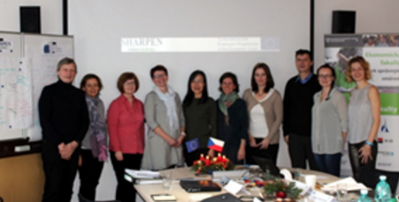
SMEs HRM Attraction, Retention & Performance Enhancement Network
Ruey Komulainen
Notes:
Hello! A warm welcome to the beautiful Kainuu region and Kajaani University of Applied Sciences.
My name is Ruey Komulainen and I am the marketing and management lecturer in the international business school.
Today, I am going to share my experiences to develop an idea with our partner universities to a multi-parties, multi-regions Erasmus + project – SHARPEN.
Sharpen stands for ……………

Slide 2
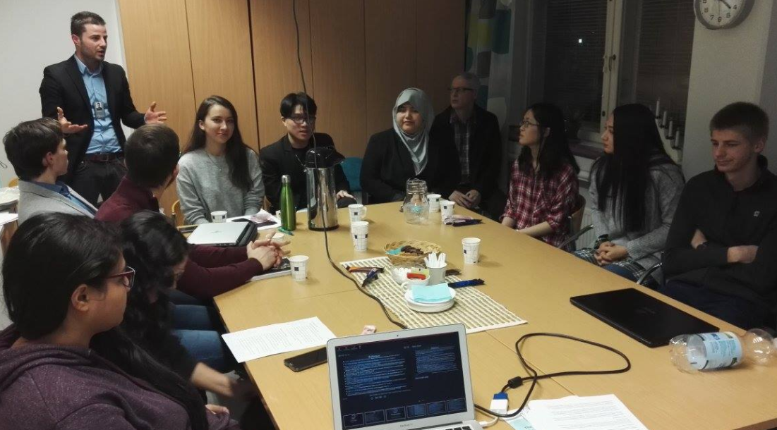
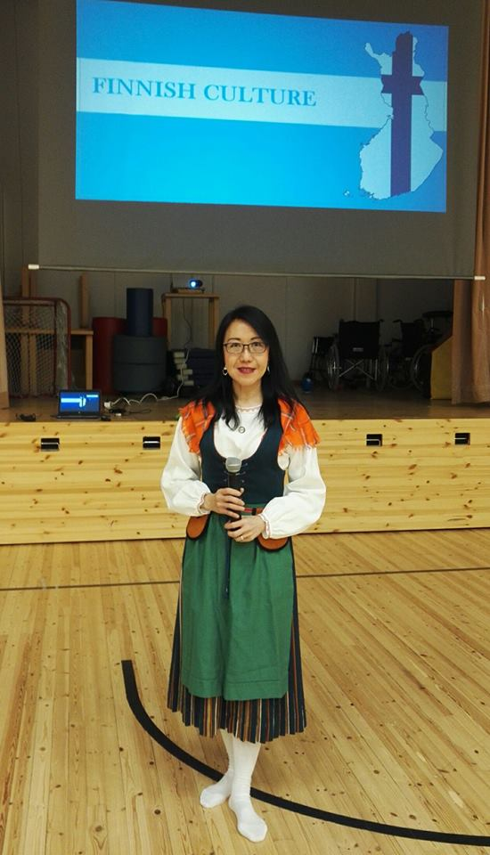



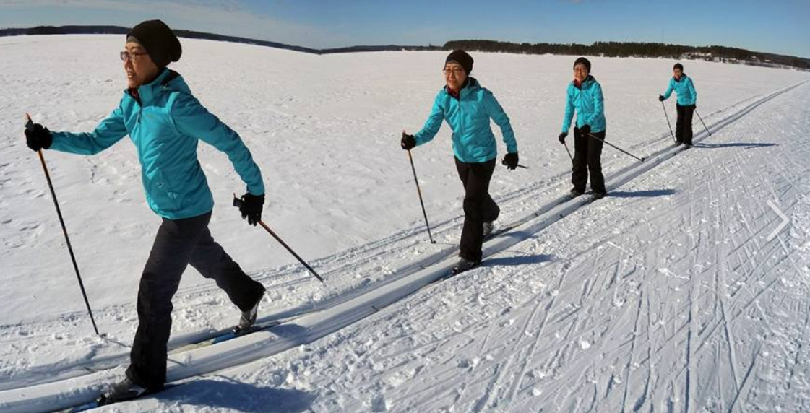



Slide 3

From Idea to Implementation
2013
2014
2015
2016
2017
2018
Commitment continues…
2019

Slide 4


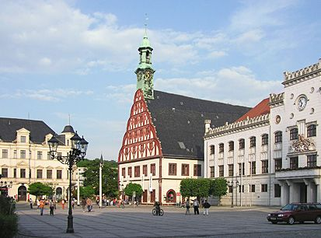

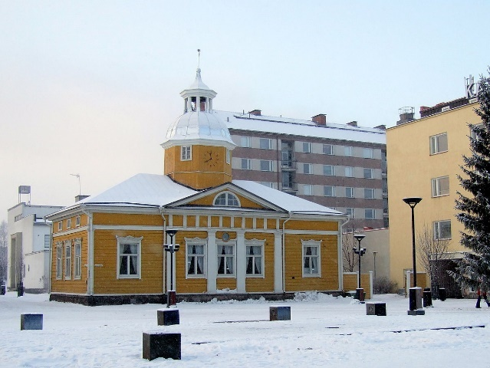

Czech Republic
The Partners
Germany
Lithuania
Finland
United Kingdom

Slide 5
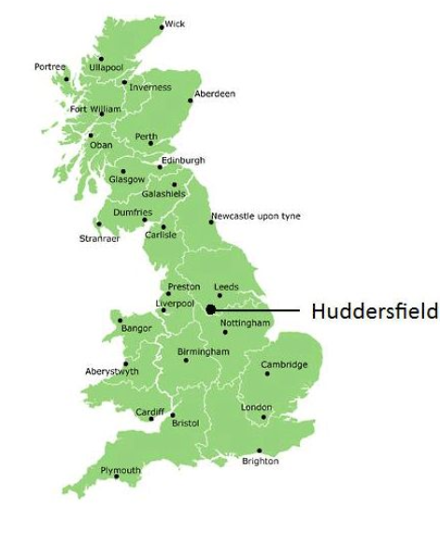
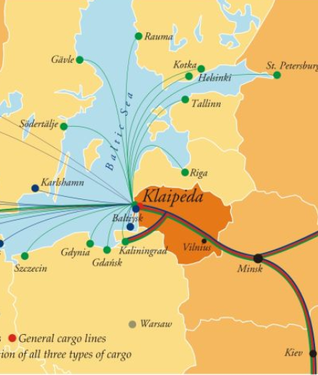
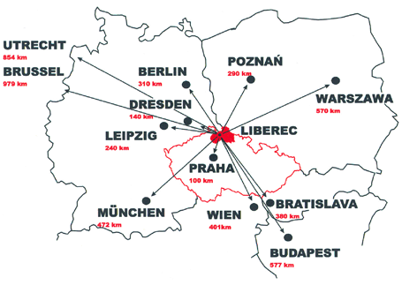
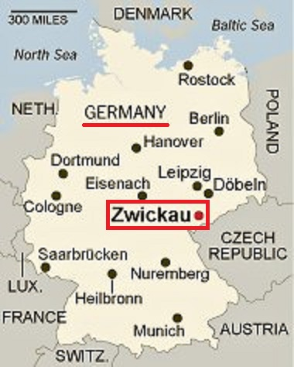
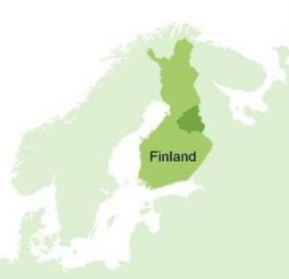
The diverse 'Partnership'
with a common identity, hrm issues, goals
HRM for SMEs
Research university, English taught program, master and PhD students
Research university, Czech-language taught program, bachelor and master students
University of Applied Sciences, Lithuanian-language taught program, bachelor students
University of Applied Sciences, German taught program, bachelor and master students
University of Applied Sciences, English and Finnish taught program, multi-disciplines bachelor students
Leader

Slide 6

Project Objectives
Deepen students’ understandings of HRM issues in SMEs
Connect theories to practice in a real life project with regional SMEs
Produce practical HRM tools and frameworks for SMEs
Migrate best practices across regions and SMEs
Notes:
Next, I would like to highlight the key objectives of the SHARPEN project.
HRM issues in SMEs
Apply theories learned to practice
SMEs have limited competencies and resources to address people issues effectively. So, we hope to develop some simple tools to help them manage people more effectively since people is a key differentiator for SMEs.
Share best practices across the regions to help SMEs develop their people management competencies.

Slide 7
Three outputs
Output 1: Learning Module
  HRM course focusing on SME environment + one week Intensive Study Program (like now in Kajaani)
Output 2: eHandbook for SMEs
  Practical tools, case studies for SMEs
Output 3: Collaborative research
  Primary data collection, publication of scientific articles;
  Comparative analysis (Ms. Tuula Rajander will summarize key findings)
Concrete Actions – What does it mean?

Slide 8
Example 2017
Concrete Actions – What does it mean?
Step 1: Study HRM theories and concepts
Step 2: Intensive Study Week in Germany
Step 3: Work with local SME(s)
OUTPUT for SMEs in eHandbook and Videos (31.8.2019):
Summary of key HRM Practices suited for SMEs
Practical Case Studies to illustrate practices (annonymous)

Slide 9


A successful
‘’ ‘’
SME employer and its employees

Slide 10




The Journey….
Uncertainties, Motivation affected
Shock, Accept, Adjust, Settle
Communication and reinforcements needed
Young SME merged with an established one
Strategic directions, structure, culture, competencies changes
Happy family post-merger
Notes:
Managing teams
Gallop
70% disengaged
20% of these are actively disengaged
Addressing the human needs – recognize, motivate
Making your employees feel good, empower them and recognize their contributions, understand their needs
Higher engagement creates stability, happy employees, satisfied customers, higher profitability and growth

Slide 11


Hire, Train, Retain, Grow

Slide 12


Slide 13


Slide 14

OUTPUT AND CASE will be PUBLISHED in the e-HANDBOOK end of summer 2019. Watch this space!

Slide 15

Why Am I Here?
Identify common challenges
Share best practices
Disseminate research results
Understand challenges, explore solutions
Support and collaborate!

Slide 16
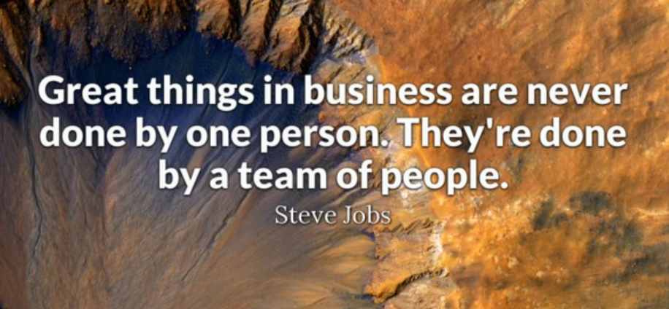

Slide 17
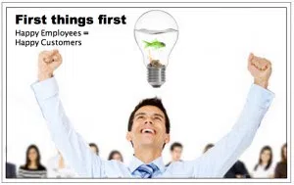
HAPPY EMPLOYEES
=
HAPPY CUSTOMERS

Slide 18
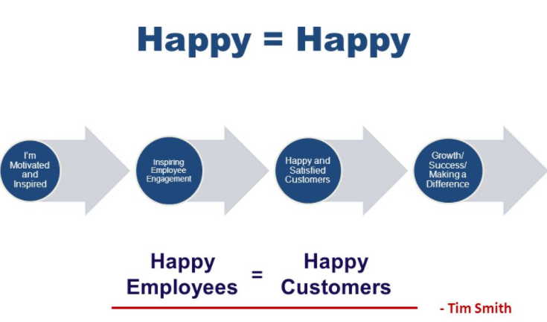

Slide 19

Hire, Train, Retain, Grow
Notes:
Small can also be an advantage

Slide 20

Networking Dinner
Listen to other SME’s and regions too….

Slide 21

Workshop
Please share actively during the workshop!

Slide 22
Workshop tonight (SMEs and KAMK staff)
Facilitator: Päivi Auno, TA2 1L 145
Facilitator: Tuula Rajander, TA2 1L 146
Heli Itkonen, KAMK
Kari Kinnunen, Kainuun-etu
Timo Komulainen, Tietohippu Oy
Pia Haapalainen, Aikopa
Pasi Pellikka, Sihti
Leili Mård, Critical Force
Petri Heikkinen, Critical Force
Mikko Kerttula, CEMIS
Camilla Maunu, Kainuun Yrittäjät
Johanna, Kalevala Valmennus
Dr. Katerina, TUL
Dr. Vivianna
Reda, SMK
Hännele Siipola, KAMK
Merja Enberg, KAMK
Hanna Turunen, KPO
Petra Heikkinen, Critical Force
Carl Wideman, Kainuun-etu
Elisa, Critical Force
Niko Lappalainen, Collapick
Kimmo Rusanen
Jyrki Komulainen, Kajaani city
Pekka Agarth, Photography Pekka Agarth
Dr. Jaraslov, TUL
Dr. Julie, HUD
Dr. Liz Rivers, HUD
Daiva, SMK

Slide 23
Workshop tonight (students)
Facilitator: Janus, Ruey, Ondrej, TA2 1L 147
ALL SHARPEN STUDENTS

Slide 24


Slide 25
SMEs HRM Attraction, Retention & Performance Enhancement Network
INDIVIDUAL OUTPUT (5 + 5 mins)
Themes | Post-It Ideas (Individual)
Attraction, recruitment and selection
Retention, development and training
Performance and reward management
Employee relations and regulations
Others

Slide 26
SMEs HRM Attraction, Retention & Performance Enhancement Network
TEAM OUTPUT (15 + 25 mins)
Challenge 1
Challenge 2
Challenge 3
Solution 1a
Solution 2a
Solution 3a
Solution 1b
Solution 2b
Solution 3b
Notes:
Welcome to the SHARPEN project learning modules.
This is a ten credit specialization course in Human Resource Management.
SHARPEN stands for SME’s HRM Attraction, Retention and Performance Enhancement Network.

