Slide 1
SMEs HRM Attraction, Retention & Performance Enhancement Network
Ruey Komulainen, Project Manager Kajaani University of Applied Sciences

Slide 2

Welcome to Kajaani!

Slide 3
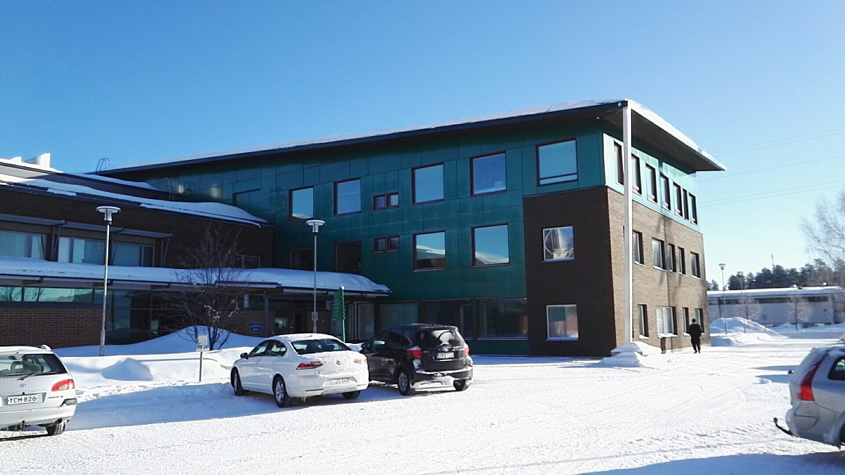
Welcome to Kajaani University of Applied Sciences!

Slide 4




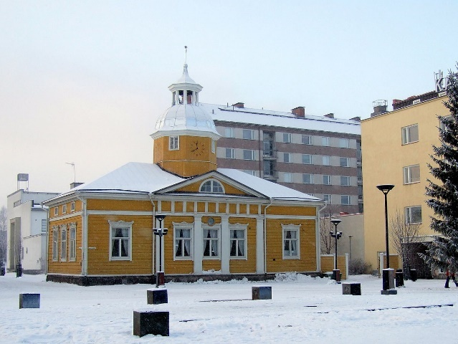

Czech Republic
The Partners
Germany
Lithuania
Finland
United Kingdom

Slide 5
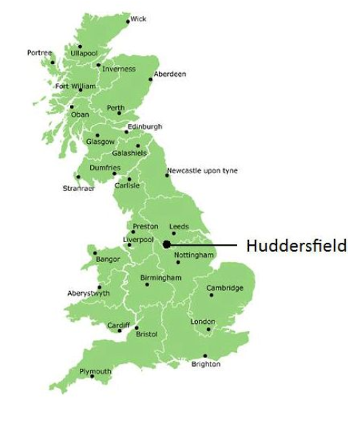
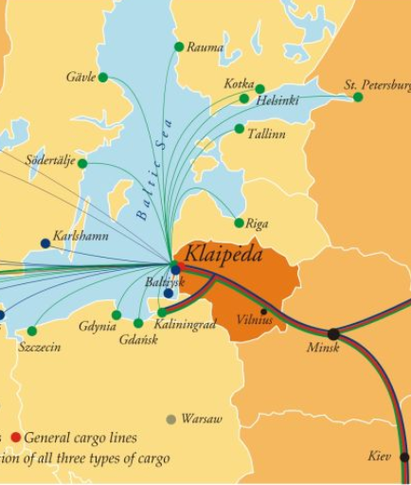
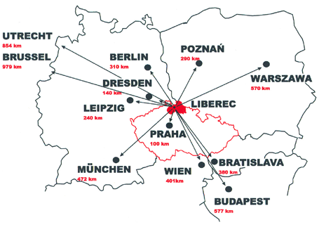

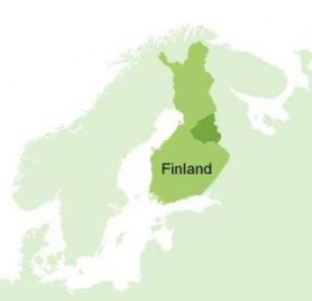
The diverse 'Partnership'
with a common identity, goal
HRM for SMEs
Research university, English taught program, master and PhD students
Research university, Czech-language taught program, bachelor and master students
University of Applied Sciences, Lithuanian-language taught program, bachelor students
University of Applied Sciences, German taught program, bachelor and master students
University of Applied Sciences, English and Finnish taught program, multi-disciplines bachelor students
Leader

Slide 6

Project Objectives
Understand HRM issues in SMEs
Connect theories to practice in a real life project with regional SMEs
Produce practical HRM tools and frameworks for SMEs
Migrate best practices across regions and SMEs
SMEs
Practical Tools
Notes:
Deepen students’ understandings of HRM issues in SMEs
Apply HRM theories and competencies to a real life project in collaboration with regional SMEs
Produce practical HRM tools and frameworks for SMEs
Migrate best practices across regions and SMEs

Slide 7



Intensive Study Program
Main Objectives
Deeper knowledge of SMEs and the partner regions
Multi-cultural, diverse learning environment
Create practical solutions

Slide 8
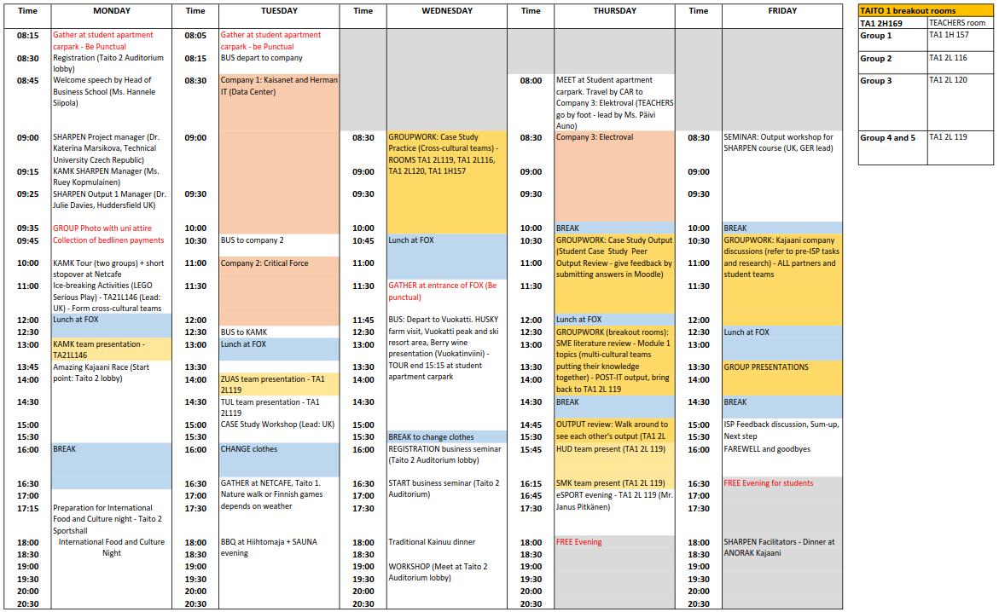
Intensive Study Program 2018
You will see this in all
the rooms for SHARPEN
Activities
A copy is in your welcome folder too

Slide 9
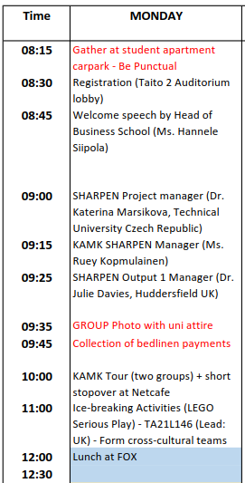
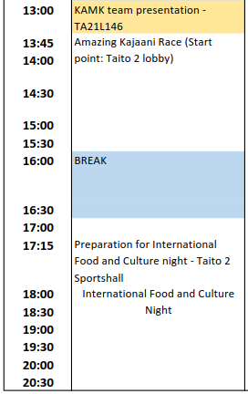
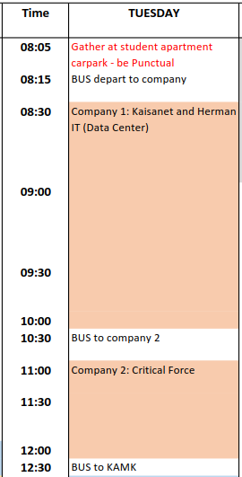
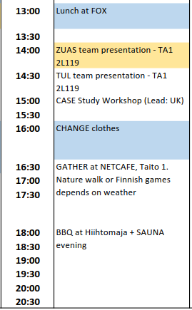
ISP: 23-24.4.2018
Meet at 16:15 in Netcafe

Slide 10
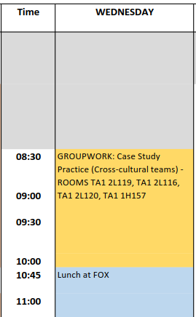
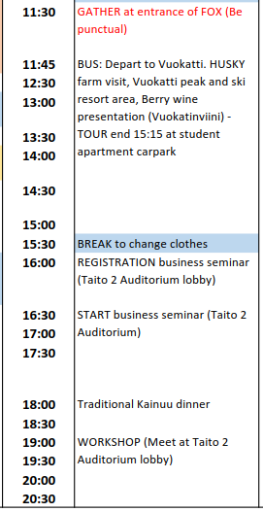
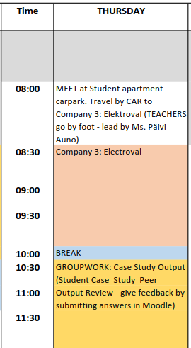
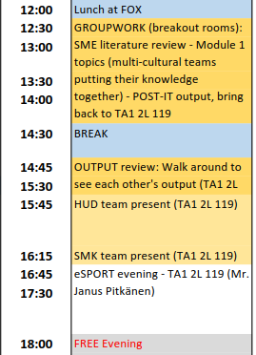
ISP: 25-26.4.2018

Slide 11
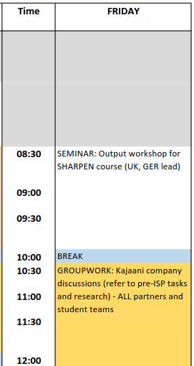
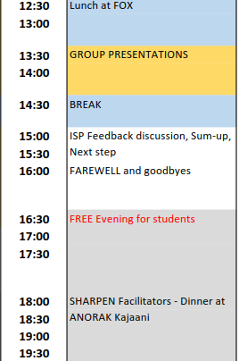
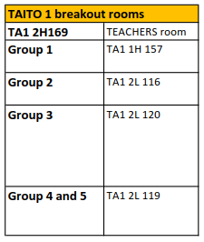
ISP: 27.4.2018
Pre-ISP company visit tasks

Slide 12

WIFI info
Only in university buildings
NETNAME: Sharpen
Password: sharpen2018
Cable connection in the apartment. NO WIFI.

Slide 13

Student apartment: Check-Out
Read the rules carefully
Sweep your own room
Ensure all the utensils and cutlery are washed
Fold and put the duvet and pillow into the BIG plastic bag
Used towel, bed linen, bedsheets, pillowcase fold and placed into the SMALL plastic
Placed the bags in front of your room door
Hand the keys to the organizer
Remember to take your key along. There is a penalty charge if to open locked door

Slide 14
ISP Teams
Team 1
Marc Lewis
Barbora Paterová
Dovilė Valantinienė
Izabela Michalczyk
Gero Jahn
Nikke Marjomaa
Team 2
Aleksandra Suslova
Karolína Palečková
Viktoras Mišlinskas
Dorra Jebali
Lena Hantzsche
Valtteri Lamberg
Team 3
Ha Aile
Gabriela Prokopová
Dovydas Šaulys
Kerry Lunn
Jessica Melzer
Jalmari Kunnari
CREATE YOUR OWN TEAM NAMES
Team 4
Adeel Patras
Karolína Kapounová
Ignas Jankevičius
David Foster
Kathrin Focht
Team 5
Yasir Adnan
Pavel Doubek
Gabija Šukytė
Luke Oldridge
Anna Wollner

Slide 15
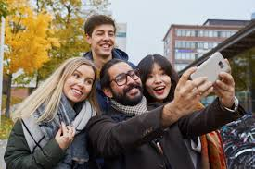

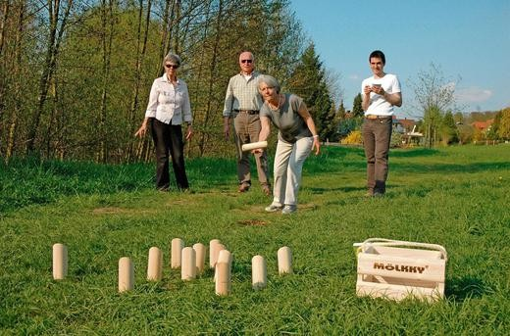
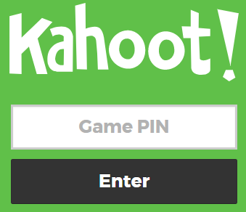



Friendly Matches
Mixture of competencies – both mental and physical
EACH MATCH
Winner: 50 points
2nd: 40 points
3rd: 30 points
4th: 20 points
5th: 10 points

Slide 16
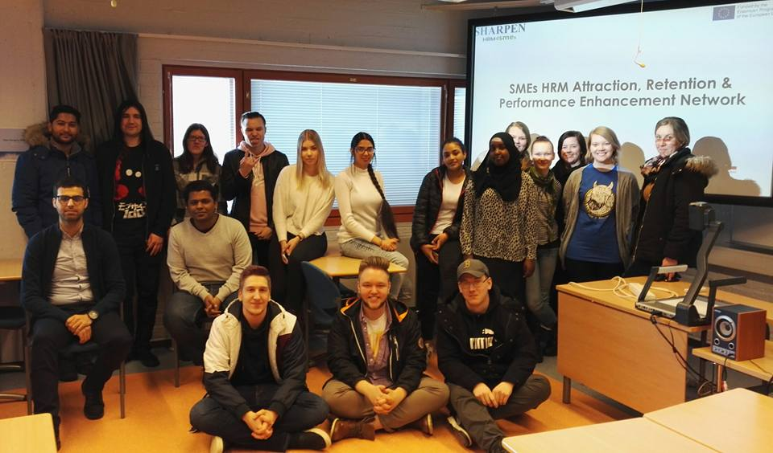
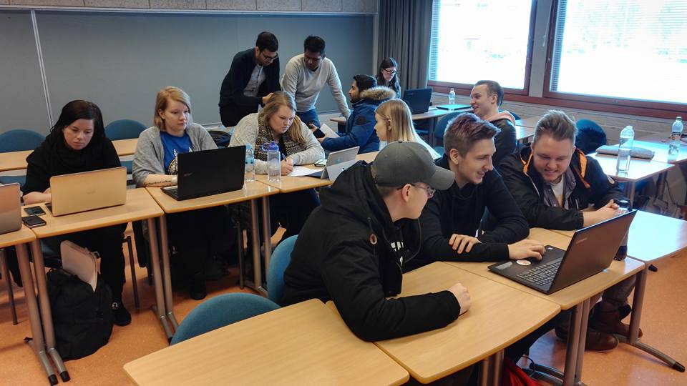
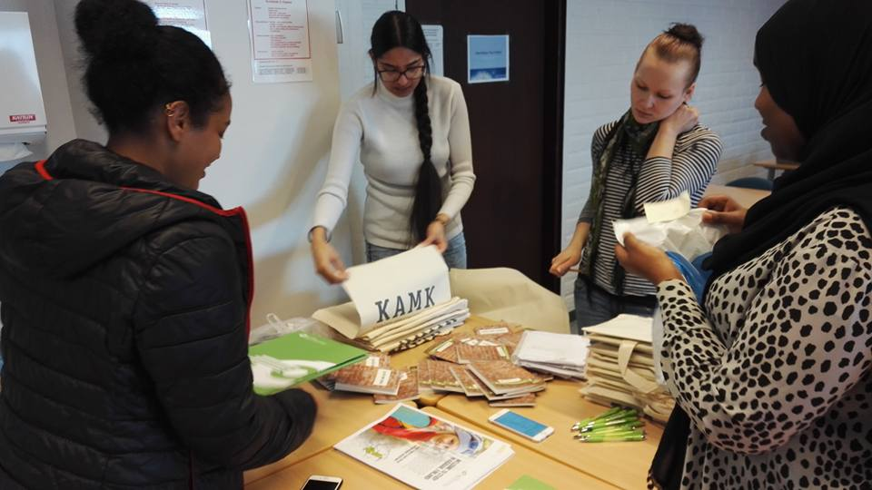
The Event Organizers

Slide 17


